Slide 1

Portfolio Executive Committee (PEC) Review Meeting
TA MHEH
To insert a wordmark:
Add (e.g. via drag and drop) your wordmark file (in RGB) to this slide (in alignment with our brand governance and architecture guidelines)
Change the size of the wordmark according to the height reference (magenta placeholder)
Select the “guides” in the navigation bar and move the wordmark to the right and top line (orange)
  Yuting Li, Freya Zhu| 23 Apr 2026 | 10 min

Slide 2
Part I:
Follow-up Actions from the Previous PEC
PEC action log

Slide 3
Part II: Discussion/Endorsement

Slide 4
Part III: Update

Slide 5

TA MHEH Portfolio Summary - Pipeline Project
Eye Health
A successful meeting was held on Apr 17th. with Experimental Medicine EH LT to introduce China capability in early clinical development.
Follow-up activities with BCL-XL inhibitor, anti-VEGF/TNFα and IVT-XR (NCE) teams are planned to explore early phase study opportunities (e.g. FIH, PoM)
Ongoing/under planning
Under evaluation
Next wave
PAFR
GA
2026
2027
Anti-Sema3A
NPDR
CI-DME
iRVO
2027
BCL-xL inh
nPDR
2029
2031
STING inhibitor
DME
SSTR4 ag
CIAS
PKKi
DME
nAMDp
2026
2027
2029
mGluR4 NAM
BPD
Anti-VEGF/TNFa
nAMD
FZD4_LRP5
CI-DME
2030
GOATi
OUD
Anti-C3
GA
2027
2026
Eye Health
Mental Health
Eye Health
Stop/
Park
Sustain
FIH-PoC
Post PoC
CS-FIH
Further alignment might be needed due to potential ethnic difference in disease.
FiH
PoC
CN App
Notes:
感谢Lincy Alex

Slide 6
2026 TA Key Milestone Overview – Eye Health
Global milestones
ARVO/
4Sight NETWORK (DR/DME and AMD/GA)
2026 Visionary Pathway
PKKi - DME
THULITE Ph2b IA
PAFR - PoC
PKKi - PoC
Anti-VEGF/TNFa – nAMD SoD
BCL-xL inh – DR SoD
Anti-VEGF/TNFa – CS
From Apr-Jul
C3 peptide inh. IVT XR – CS moved to 2027 Q1/Q2
STING IVT XR – DME SoD
aC3 – GA
Light GBP Workshop
aC3 - GA
VERDANT Ph2b IA
PAFR - GA
JADE Ph2b IA
BCL-xL inh – CS (from May-Sep)
aC3 XR – CS from Aug to end of 2026
PKKi – nAMD
Global Think Tank
Anti-Sema3A - DR
CRIMSON Ph2b LPI
FZD4/LRP5 - DR/DME
Ph1/2 FPI
PKKi - DME
THULITE Ph2b LPI
JAN | FEB | MAR | APR | MAY | JUN | JUL | AUG | SEP | OTC | NOV | DEC
China milestones
PKKi - DME
THULITE Ph2b China FPI
Anti-VEGF/TNFa
Ph 1/2 China Integration Strategy
PKKi - DME
THULITE Ph2b LPI
GA
COMPASS IA2
China Top Tier KEE Mapping
GA
COMPASS IA1
THULITE China Workshop
DR/DME RWS
GA NAB
PKKi – DME
THULITE Ph2b China IM
BCL-xL inh
Ph 1/2 China Integration Strategy
GA Scientific Exchange Meeting with KEE
GA Pipeline HAI
Phase I
Phase II
Phase III
Other Activities
1st Submission
CS (SoD)
PoC
RoFD
TLR
HAI
Study start/ read-out
Termination
Milestone

Slide 7
2026 TA Key Milestone Overview – Mental Health
Global milestones
SSTR4 ag – CIAS
Path to PoC (IUPC)
mGluR4 NAM – Imp in BPD
Global AB
mGluR4 NAM – Imp in BPD
CoA prototype (FDA)
mGluR4 NAM – Imp in BPD
Path to PoC (IUEC)
GOATi – Other SuD/Imp
Global AB
COMTi – Fx in SCZ
Termination
mGluR4 NAM –
Imp in BPD
CoA Obs FPI
Delicado – SZ SoD
SSTR4 ag – CIAS
Ph1b FPI
COMTi – Fx in SCZ
Back-up CS
JAN | FEB | MAR | APR | MAY | JUN | JUL | AUG | SEP | OTC | NOV | DEC
GOATi–OUD
Ph2a PoC China Integration discussion
mGluR4 NAM – Imp in BPD
Ph2a PoC China Integration Strategy
mGluR4 NAM – Imp in BPD
CoA China Bridging Strategy
China milestones
Introduction of China Overview in Global ExpMED N&MH Community Forum
mGluR4 NAM – Imp in BPD
China NAB
Phase I
Phase II
Phase III
Other Activities
1st Submission
CS (SoD)
PoC
RoFD
TLR
HAI
Study start/ read-out
Termination
Milestone

Slide 8
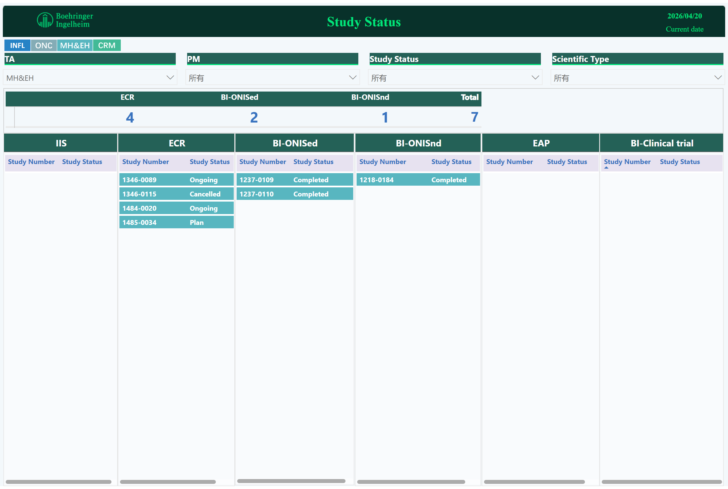
Study Status
TA MH&EH Portfolio Summary - PMS Studies
1346-0089, (BJ Perfect)→ongoing
Study data analysis will be completed in Jun 2026.
1484-0020, (COMPASS)→ongoing
Study is in the enrollment stage.
1485-0034, (DR and DME)→plan
Study proposal released on Apr 9th (later than endorsed timeline)
Potential delay in protocol approval
1346- GlyT1
1484- PAFR and anti-C3
1485- Anti sema3A and Pkki
Notes:
ECR
No alt text provided
pivotTable
No alt text provided
image
No alt text provided
textbox
No alt text provided
textbox
No alt text provided
card
No alt text provided
IIS
No alt text provided
slicer
No alt text provided
slicer
No alt text provided
slicer
No alt text provided
slicer
No alt text provided
BI-ONISed
No alt text provided
BI-ONISnd
No alt text provided
EAP
No alt text provided
BI-Clinical trial
No alt text provided
image
No alt text provided

Slide 9
Mature Product/PMS Overview - MH&EH
Product/Study | Indication | Study type (Study no.: FPI-LPO, CTR) | Current status | Next Milestone | Key Updates
GlyT1 (BJ-PERFECT VR Version Validation) （Peking University Sixth Hospital， Prof. Shi） | BJ-PERFECT VR Validation and norm | ECR (1346-0089; Sep 2024- Dec 2025, Dec 2026) | Data analysis completion (Mar 2026) | Data analysis completion (Jun 2026) | Data analysis has been conducting Sponsor-investigator is preparing study report
PAFR and anti-C3 (COMPASS) （Chinese Academy of Medical Sciences & Peking Union Medical College, Prof. Chen） | GA | ECR 1484-0020 (Jun2025-Oct 2027, May 2030) | FPI （Jun 2025） | 1st interim analysis （Mar 2026） | Contract was signed on 12 May 2025. The 1st interim analysis completed on 27 Feb 2026 Study recruitment progress: Study recruitment progress: Retrospective part: 120/63 (+1 than last month); Prospective part: 70/14(+3 than last month); Site initiation progress: 16/10(+0 than last month)
anti sema3A and Pkki (Patient journey and treatment pattern and of DR and DME in China (Peking University Third Hospital, Zhuolin) | DR and DME | ECR 1485-0034(Jan 2026-Dec 2026，Jun 2027) | Proposal release (Apr 2026) | Protocol approval (Apr 2026) | Proposal global release completed on 9 Apr 2026

Slide 10
Eye Health Assets

Slide 11
Overview of Eye Health Early Assets for China Integration
2028
2025
2026
Today
2027
2028
Jan
Apr
Jul
Oct
Jan
Apr
Jul
Oct
Jan
Apr
Jul
Oct
aC3
GA – gPh2 (1479-0002, VERDANT)
PoC, Feb 2027
GA – gPh3 (1479-0003/0004)
Nov 2027
PKKi
Feb 2026
DME – gPh2 (1485-0018, THULITE)
PoC, Oct 2026
DME – gPh3 (1485-0019/0020)
Aug 2028
Acceleration under discussion
nAMD – gPh2 (1485-0004)
Aug 2028
aSema3A
NPDR – gPh2 (1436-0007, CRIMSON)
PoC, May 2027
NPDR – gPh3 (1436-0009/0010)
May 2028
PDR – gPh3 (1436-0012)
May 2028
GA – gPh2 (1484-0005, JADE)
PAFR
PoC, Aug 2026
GA – gPh3 (1484-0015/0016)
Feb 2028
FZD4/
LRP5
CI-DME – gPh1/2 (1523-0001)
PoC/RoFD, Jul 2027
CI-DME – gPh3 (1523-0003/0004)
May 2028
Potential acceleration
Further alignment might be needed due to potential ethnic difference in disease.

Slide 12


BI 1815368 / PKKi, Diabetic Macular Edema (DME), Development Plan
2025 |  |  |  | 2026 |  |  |  | 2027 |  |  |  | 2028 |  |  |  | 2029 |  | 2030
Q1 | Q2 | Q3 | Q4 | Q1 | Q2 | Q3 | Q4 | Q1 | Q2 | Q3 | Q4 | Q1 | Q2 | Q3 | Q4 | H1 | H2 | H1 | H2
Today
Oct 2026
May 2025
Sep 2026
Nov 2027
Global Update:
THULITE Ph2 Ongoing: : 61 patients enrolled vs.153 planned, by 24 Apr;
Ph2 -
1485-0018
THULITE
THULITE Ph2, N=300
FPI
LPI
IA*
Key results
Ph3 -
1485-0019/
1485-0020
PoC *
FPI
2 x Ph3
Aug 2028
21 Jan2026
26 Jan 2026
Sep 2026
Mar 2025
Nov 2027
Ph2 -
1485-0018
THULITE
CTA Review + EC + HGRAC + Contract
Ph2, N=8
THULITE Trial Update:
All 5 sites activated by 30 Mar.
Recruitment:
  FPS achieved: 27 Mar.
  Screened: 3 actual vs. 6 planned (1 Screen failure; 2 ongoing)
  Pre-screened: 431 patients (incl. 16 PI-referred); 29 high potential patients further assessed with 22 failed (incl. 7 refusals)
Other:
Site engagement:
  CHN2 (West China Hospital) visited for recruitment boost on 8 Apr
Key results
CTA Sub
CoA
1st SIV
LPI
12
China CIQ: China Entry-Exit Inspection and Quarantine; nAMD: neovascular age-related macular degeneration

Slide 13
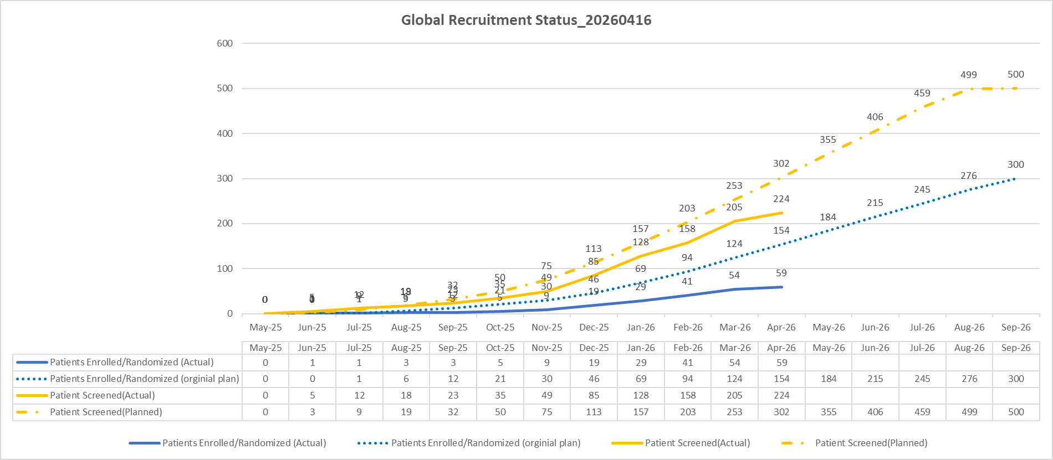
Recruitment Status - Global

Slide 14
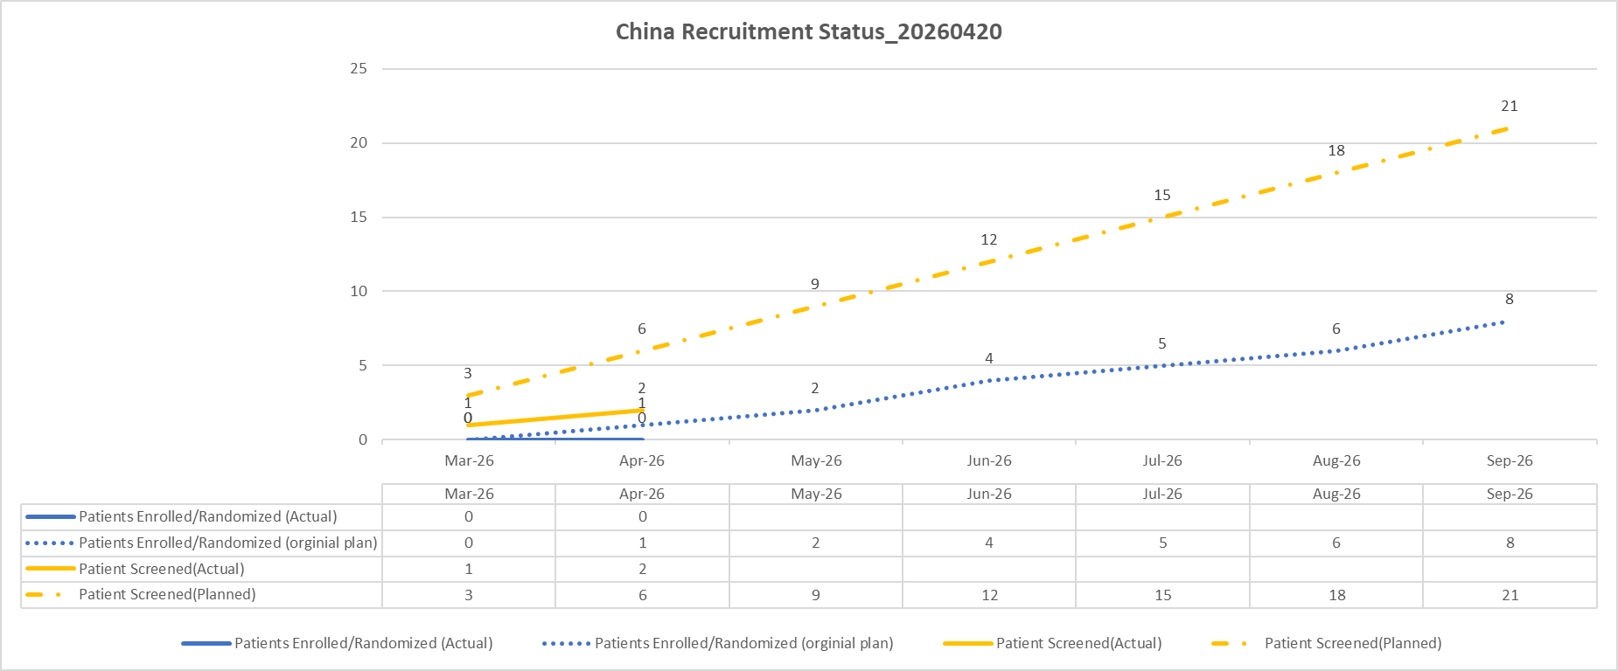
Recruitment Status - China

Slide 15
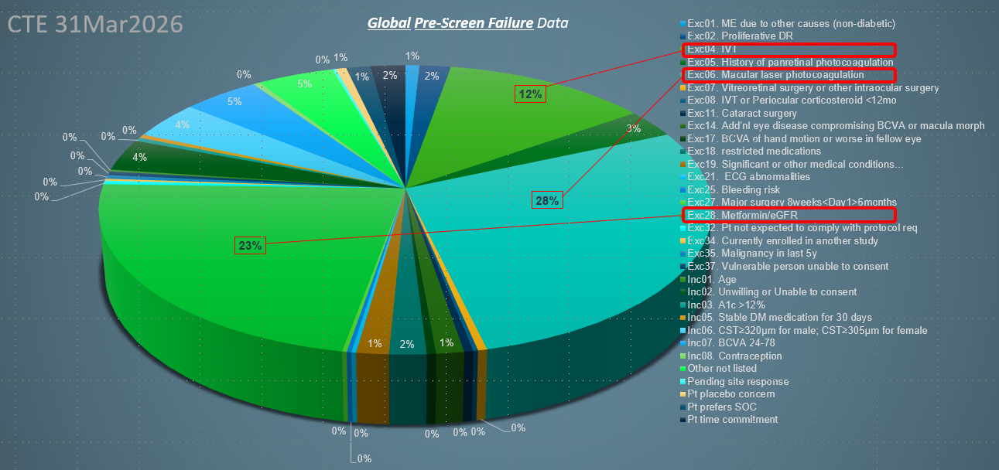
Pre-screen Failure Reasons: China vs. Global with Similarity and Differences
China Pre-Screen Failure Data_20260420
Global Pre-Screen Failure Data_20260331
VS.
Similarity
IVT history
Differences* （China)
Joining other trials
  Patient Refusal
  PRP Laser
  Macular Laser
  Metformin
To be optimized
Actions taken by local team to promote recruitment:
Conducted 3 site engagement visits since SIVs to enhance recruitment efforts.
Maintained close collaboration with the IQVIA China team through:
  Weekly updates on site recruitment status, including pre-screening number and reason.
  Bi-weekly catch-up meetings to discuss site recruitment challenges and align strategies.
  Regular huddle meetings with BI & IQVIA global and local teams.
Performed detailed recruitment analysis for each site, including:
  Evaluation of recruitment routes and measures implemented.
  Identification of challenges and development of mitigation strategies.
Due to local treatment pattern
*Some differences are due to different starting point or screening funnel

Slide 16
BI 764524 / Anti-Sema3A, Diabetic Retinopathy (DR), Development Plan
2025 |  |  |  | 2026 |  |  |  | 2027 |  |  |  | 2028 |  |  |  | 2029 |  | 2030
Q1 | Q2 | Q3 | Q4 | Q1 | Q2 | Q3 | Q4 | Q1 | Q2 | Q3 | Q4 | Q1 | Q2 | Q3 | Q4 | H1 | H2 | H1 | H2
Today
Ph2b -
1436-0007
CRIMSON
May 2024
Apr 2026
May 2027
Oct 2027
Global Update:
  Phase IIb CRIMSON: LPI milestone achieved on 3 Apr, approximately one month ahead of revised projections
Ph2b in NPDR without CI-DME, CRIMSON, N=178
FPI
LPI
52-wk key results
Final results
May 2028
May 2029
May 2030
Sep 2030
PoC
2 x Ph3 in NPDR wo CI-DME
1 x Ph3 in PDR
Ph3 -
1436-0009/
1436-0010/
1436-0012
FPI
LPI
52-wk
primary results
NDA sub.
China Update:
  DR/DME ECR based on Beijing Healthcare Insurance Study:
    Proposal approved and released on 9 Apr
    Ophthalmology investigator, Prof. Kang Feng, proposed and engaged F2F on 31 Mar
  Global/China brand team regular meeting kicked off on 25 Mar.
Oct 2030
Ph3 -
1436-0009/
1436-0010/
1436-0012
May 2029
CTA Review + EC + HGRAC + 1st SIV
Ph3 in NPDR without CI-DME
Ph3 in PDR
CTA Sub
1st SIV
LPI
CN NDA sub.
16
DR: Diabetic Retinopathy; CI-DME: Center-Involved Diabetic Macular Edema; RNP: Retinol Non-Perfusion; PRP: Panretinal Photocoagulation

Slide 17
BI 771716 / Anti-C3 AB, Geographic Atrophy (GA), Development Plan
2025 |  |  |  | 2026 |  |  |  | 2027 |  |  |  | 2028 |  |  |  | 2029 |  | 2030
Q1 | Q2 | Q3 | Q4 | Q1 | Q2 | Q3 | Q4 | Q1 | Q2 | Q3 | Q4 | Q1 | Q2 | Q3 | Q4 | H1 | H2 | H1 | H2
Today
Ph2 -
1497-0002
VERDANT
Jan 2025
Sep 2025
May 2026
Jan 2027
Global Update:
IA to be achieved in May with GNG decision.
VERDANT Ph2b in GA, N=180 (US)
FPI
LPI
IA
Key results
Feb 2027
May 2027
Oct 2027
Oct 2028
Nov 2029
May 2030
Dec 2030
Ph3 -
1497-0003/
1497-0004
2 x Ph3 in GA
PoC
RoFD
FPI
LSS
Primary results
NDA sub.
Key results
Sep 2027
Mar 2028
Jun2030
Ph3 -
1497-0003/
1497-0004
CTA Review + EC + HGRAC + 1st SIV
Ph3 in GA
CTA Sub
1st SIV
LPI
NDA sub.
China Update:
GA pipeline consultation: BB input completed and under review by global LT. Submission targeted by Apr/May depending on question list alignment with global.
Local workshop planned in May to evaluate the impact of different Ph3 integration scenarios and evidence generation plan.
17
Notes:
Izervay, the C5 inhibitor from Astellas, with registrational trials (GATHER1 & GATHER2 in US/EU) demonstrating positive results in reduction in GA lesion growth but no significant effect in visual function, was approved by FDA (2023), rejected by EMA, and now conditionally approved by PMDA in Sep 2025 waiving clinical data in Japanese patients. External information shows that an experts consultation panel was organized by CDE recently to evaluate Izervay approval in China waiving clinical data in Chinese patients. Local team is closely monitoring on the status.

Slide 18
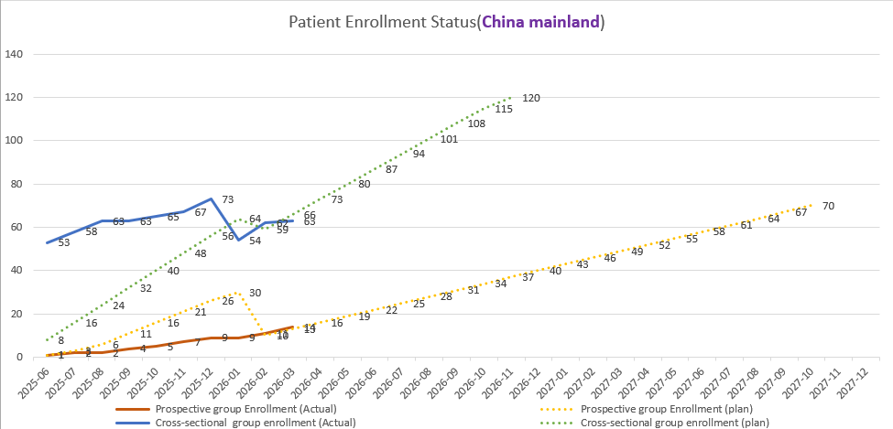
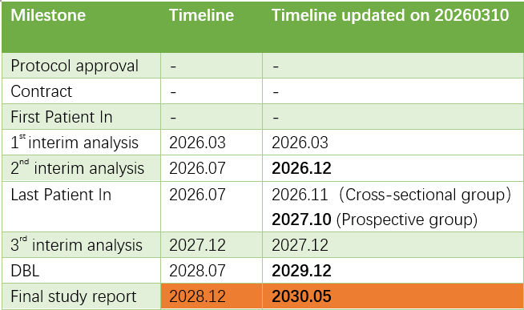
1484-0020 COMPASS BI 771716 / Anti-C3 AB, GA, China Recruitment
Cut-off date: 2026.03.31
Total Enrollment:
Prospective group: 14(+3)/70
Cross-sectional group: 63(+1)/120
Site initiation: 10/16
Study timeline was confirmed by Sponsor in Mar and endorsed by CEC in Apr.
Report of retrospective analysis on APVRS (Aug 2026): APVRS submission achieved in Apr.

Slide 19
BI 1815368 / PKKi, Diabetic Macular Edema (DME), Development Plan
2025 |  |  |  | 2026 |  |  |  | 2027 |  |  |  | 2028 |  |  |  | 2029 |  | 2030
Q1 | Q2 | Q3 | Q4 | Q1 | Q2 | Q3 | Q4 | Q1 | Q2 | Q3 | Q4 | Q1 | Q2 | Q3 | Q4 | H1 | H2 | H1 | H2
Today
Global Update:
THULITE Ph2 Ongoing: IA reprojected to Oct*.
  Early-discontinuation** rate higher than estimated
  “Global Huddles”- Regular joint meeting set up for China & Japan (global/local/IQVIA)
  Global IEP update in progress
  * Recruitment delay: 46 patients enrolled
  ** Maily due to violation of eligibility criteria
Oct 2026
May 2025
Sep 2026
Nov 2027
Ph2 -
1485-0018
THULITE
THULITE Ph2, N=300
FPI
LPI
IA*
Key results
Ph3 -
1485-0019/
1485-0020
PoC *
FPI
2 x Ph3
Aug 2028
21 Jan2026
26 Jan 2026
Sep 2026
Mar 2025
Nov 2027
Ph2 -
1485-0018
THULITE
CTA Review + EC + HGRAC + Contract
Ph2, N=8
Key results
THULITE Trial Update:
SIV: All 5 sites initiated and 3 activated.
IMP: Site shipment delay due to Almac issue
Recruitment status: 15 patients prescreened, 5 failed, 2 proceeded to screening
Other:
Site engagement:
  Leading site SIV (Feb 24)
  CHN5 site boost visit for recruitment discussion (Mar 06)
CTA Sub
CoA
1st SIV
LPI
19
China CIQ: China Entry-Exit Inspection and Quarantine; nAMD: neovascular age-related macular degeneration

Slide 20
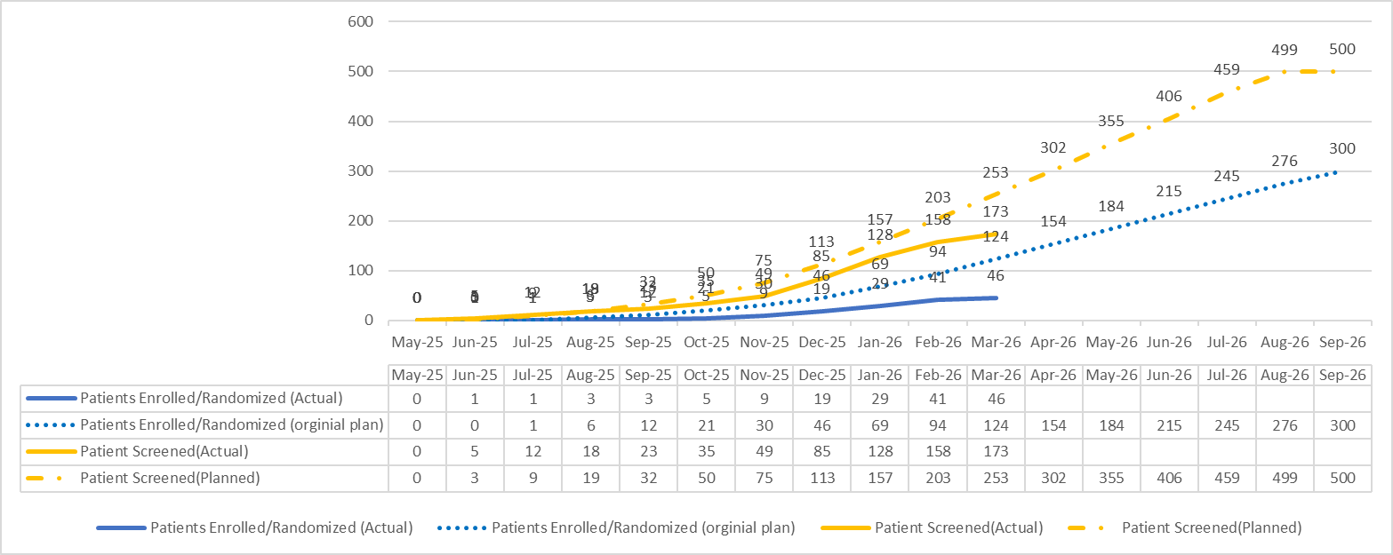
1485-0018 PKKi/DME (Global recruitment status)
As of 11 Mar 2026:
Total Screened = 173
Total Randomized = 46
Screen Failure Rate = 69%

Slide 21
1485-0018 PKKi/DME (China recruitment status)
As of 12 Mar 2026:
Total Screened = 0
Total Randomized = 0
Screen Failure Rate = 0%

Slide 22
BI 771716 / Anti-C3 AB, Geographic Atrophy (GA), Development Plan
2025 |  |  |  | 2026 |  |  |  | 2027 |  |  |  | 2028 |  |  |  | 2029 |  | 2030
Q1 | Q2 | Q3 | Q4 | Q1 | Q2 | Q3 | Q4 | Q1 | Q2 | Q3 | Q4 | Q1 | Q2 | Q3 | Q4 | H1 | H2 | H1 | H2
Today
Ph2 -
1497-0002
VERDANT
Jan 2025
Sep 2025
May 2026
Jan 2027
Global Update:
aC3 light GBP reviewed by focused country
VERDANT Ph2b in GA, N=180 (US)
FPI
LPI
IA
Key results
PoC/RoFD
Oct 2027
Oct 2028
Oct 2029
Apr 2030
Dec 2030
Ph3 -
1497-0003/
1497-0004
2 x Ph3 in GA
FPI
LPI
Primary results
NDA sub.
Key results
Ph3 -
1497-0003/
1497-0004
May 2030
CTA Review + EC + HGRAC + 1st SIV
Ph3 in GA
CTA Sub
1st SIV
LPI
NDA sub.
China Update:
GA pipeline consultation: Application submission planned by end of Apr.BB sent for global review on Mar 13. Discussion with global on consultation questions needed.
The GA scientific exchange follow up meeting with Prof. Sun on Mar 13. A high‑quality China dry AMD cohort to support GA studies under preparation by Prof. Sun’s team
22
Notes:
Izervay, the C5 inhibitor from Astellas, with registrational trials (GATHER1 & GATHER2 in US/EU) demonstrating positive results in reduction in GA lesion growth but no significant effect in visual function, was approved by FDA (2023), rejected by EMA, and now conditionally approved by PMDA in Sep 2025 waiving clinical data in Japanese patients. External information shows that an experts consultation panel was organized by CDE recently to evaluate Izervay approval in China waiving clinical data in Chinese patients. Local team is closely monitoring on the status.

Slide 23
Status for CDE Meeting
CDE Meeting Types | Scope
Type I Meeting Type II Meeting | Type I: address the major safety issues encountered during the clinical trials of drugs, and the major technical issues in the R&D process of the breakthrough therapeutic drugs or held in other prescribed situations. Type II: held at the key stages of drug R&D process, including pre-IND meeting, EOP2/Phase III pre-clinical trial meeting, pre-NDA meeting and risk assessment and control meeting. Meetings to obtain CDE official opinions with minutes Data fully reviewed
Type III Meeting | Preliminary consultation, pipeline consultation, etc Non-binding meeting High level advices on 1) key issues and 2) data sufficiency to be addressed for consultation meeting, and 3) contents to be included in briefing book for consultation meeting.
As a scientific exchange meeting, no strong commitment is expected from either perspective. The meeting minutes will be reviewed and confirmed by BI team before finalization.
*Although it may not be possible to obtain explicit answers from CDE, it is a chance for applicants/sponsors to ask questions about Agency's opinion.
BB send to global review
Mar 13th
Slides preparation near BB almost final
HAI submission
Mar/Apr
F2F meeting
Jul(75wds)*
Questions:
1.Does the Agency agree that a globally consistent GA population definition will be used, excluding non-AMD-related GA?
2.Does the Agency have comments on GA lesion size progression as the primary endpoint?
* might be written response

Slide 24
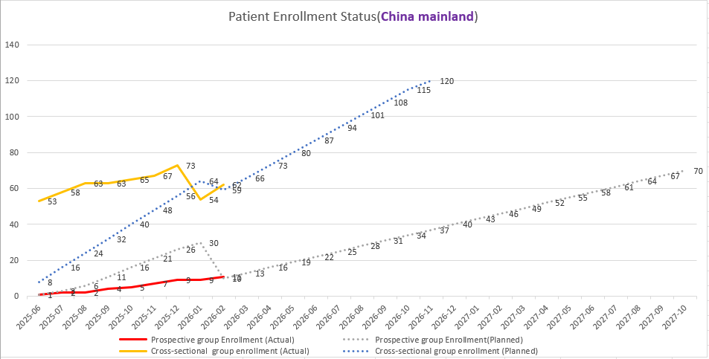
1484-0020 COMPASS BI 771716 / Anti-C3 AB, GA, China Recruitment
Cut-off date: 2026.03.02
Total Enrollment:
Prospective group: 11/70
Cross-sectional group: 62/120
Site initiation: 10/16
The updated study timeline is confirmed by PI
Report of retrospective analysis on APVRS (Aug 2026): BI review comments have been sent to sponsor-investigator.

Slide 25
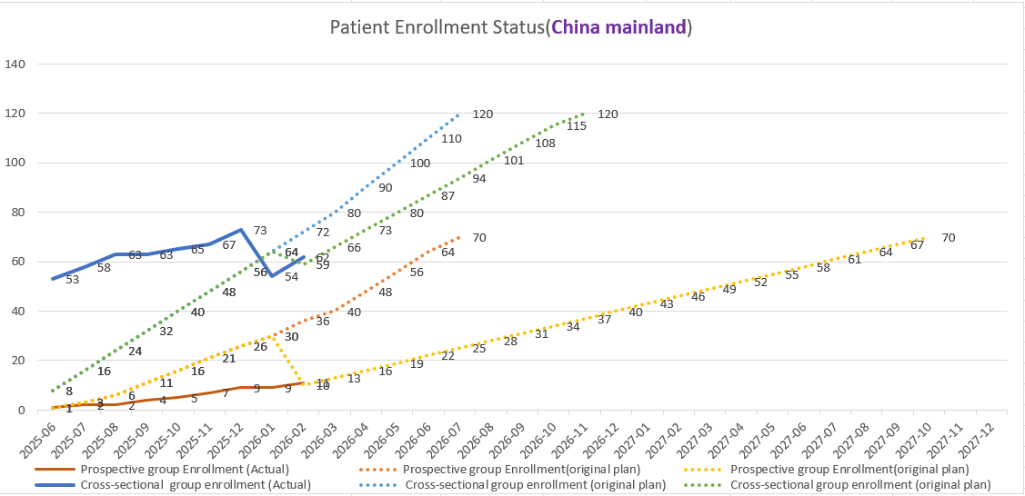
1484-0020 COMPASS BI 771716 / Anti-C3 AB, GA, China Recruitment
Cut-off date: 2026.03.02
Total Enrollment:
Prospective group: 11/70
Cross-sectional group: 62/120
Site initiation: 10/16
The updated study timeline is confirmed by PI.
Report of retrospective analysis on APVRS (Aug 2026): BI review comments have been sent to sponsor-investigator.

Slide 26
BI 764524 / Anti-Sema3A, Diabetic Retinopathy (DR), Development Plan
2025 |  |  |  | 2026 |  |  |  | 2027 |  |  |  | 2028 |  |  |  | 2029 |  | 2030
Q1 | Q2 | Q3 | Q4 | Q1 | Q2 | Q3 | Q4 | Q1 | Q2 | Q3 | Q4 | Q1 | Q2 | Q3 | Q4 | H1 | H2 | H1 | H2
Today
Ph2b -
1436-0007
CRIMSON
May 2024
Apr 2026
May 2027
Oct 2027
Ph2b in NPDR without CI-DME, CRIMSON, N=178
FPI
LPI
52-wk key results
Final results
May 2028
May 2029
May 2030
Sep 2030
PoC
2 x Ph3 in NPDR wo CI-DME
1 x Ph3 in PDR
Ph3 -
1436-0009/
1436-0010/
1436-0012
FPI
LPI
52-wk
primary results
NDA sub.
Ph3 -
1436-0009/
1436-0010/
1436-0012
China Update:
  DR/DME based on Beijing Healthcare Insurance Study:
    Proposal approved and protocol under review via lectrona
    Contract and metformin analysis expected in Aug
May 2029
Oct 2030
CTA Review + EC + HGRAC + 1st SIV
Ph3 in NPDR without CI-DME
Ph3 in PDR
CTA Sub
1st SIV
LPI
CN NDA sub.
26
DR: Diabetic Retinopathy; CI-DME: Center-Involved Diabetic Macular Edema; RNP: Retinol Non-Perfusion; PRP: Panretinal Photocoagulation

Slide 27
Eye Health KEE Mapping Overview
Objective
To systematically map and prioritize KEEs to provide a solid foundation for strategic activities, including clinical trials, scientific meetings, advisory boards, publications, etc. in DR/DME and AMD/GA.
Mid-Nov. 2025
Dec. 2025
Mid-Jan. 2026
Criteria alignment
Initial screening (List 1)
List Expansion (List 2)
Scoring and Ranking
(Top-tier List)
Review and Refinement
(Final Top-tier List)
Aligned on the KEE evaluation criteria for each indication (DR/DME and AMD/GA).
Conducted the initial screening via Monocl database.
Supplemented additional KEE candidates with domestic data sources.
Scored and ranked KEEs from Lists 1 and 2 based on predefined criteria.
Reviewed and prioritized top KEEs.
Results
List 1 = 397
List 2 = 62
Total = 459
Prioritized top 15
Notes:
基于既定的标准，识别重要KEE，为未来的活动（临床试验、会议活动、咨询、文章发表等）作为基础
流程：
团队内部商定评估标准，纳入的维度和阈值
Monocl初筛-list 1
根据国内其他数据源增补list 1漏掉的其他KEE-list 2
根据评估标准，对list 2进行打分和排序，筛选针对不同应用场景的top KEE list – list 3
团队内部review，基于对专家的了解、既往的合作等，refine 形成 final list。
11.21 kick-off, align了标准
12月进行检索和排序
12.30 review名单和做refinement
1月中final

Slide 28



Prioritized 15 KEEs – Key Activities in 2026
Global Ad Board
Congress
National Ad Board
Clinical trials
Name |  | Established Collaborations | Engagement Plan in 2026
Xun, Xu | 许迅 | 2025 NAB Chair, THULITE Leading PI
Xiao Dong, Sun | 孙晓东 | Think Tank, GA consultation |  | Potential AMD/GA trials leading PI, VP
You Xin, Chen | 陈有信 | COMPASS Leading PI, Think Tank |  | COMPASS interim results release
Xiao Xin, Li | 黎晓新 |  |  | Candidate for VP
Ming Wei, Zhao | 赵明威 | 2025 NAB |  | Potential DR, GA trials leading PI
Xiao Rong, Li | 李筱荣
Xiao Ling, Liang | 梁小玲
Da Wei, Sun | 孙大卫 | COMPASS PI
Mei Xia, Zhang | 张美霞 | COMPASS PI
Ming, Zhang | 张明 | 2025 NAB, THULITE PI
Xiang, Ma | 马翔
Su Yan, Li | 李甦雁 | COMPASS PI, 2025 NAB
Xin Yuan, Zhang | 张新媛
Wen Bin, Wei | 魏文斌
Li, Su | 苏莉 |  |  | 4Sight Network
KEE mapping results has been communicated with global team and additional engagement activities will be discussed.
China KEE involvement into 2026 APVRS AB meetings are under planning
Congress: International - ARVO, APVRS, EURETINA, APAO; Local - Retina China, CCOS (Congress of Chinese Ophthalmological Society); VP: Visionary Pathway

Slide 29
Mental Health Assets

Slide 30
Overview of Mental Health Early Assets for China Integration
2028
2025
2026
2027
2028
Jan
Apr
Jul
Oct
Jan
Apr
Jul
Oct
Jan
Apr
Jul
Oct
Today
mGluR4 NAM
ADHD & BPD – gPh1b PoM (1516-0003)
PoM, Jan 2027
Sep 2027
BPD – gPh2a PoC (1516-0032)
GOATi
gPh1b PoM (1427-0015)
PoM, Apr 2027
OUD – gPh2 PoC
(1427-0016)
Oct 2028
SSTR4
FSS for gPh1b PoM(1526-0006)
gPh1b PoM (1526-0006)
PoM, Aug 2028
Global Update:
PoM studies for mGluR4 and GOATi are ongoing with recruitment challenges.
PoM study for SSTR4 is under preparation.
China Update:
For mGluR4 and GOATi, China integration into PoC strategy under preparation
For SSTR4, possibilities of China integration into PoM discussed with global innovation team. Waiting for global team feedback. Preliminary site feasibility evaluation ongoing.

Slide 31
BI 3031185 / mGluR4 NAM, Impulsivity, Development Plan
2025 |  |  |  | 2026 |  |  |  | 2027 |  |  |  | 2028 |  |  |  | 2029 |  | 2030
Q1 | Q2 | Q3 | Q4 | Q1 | Q2 | Q3 | Q4 | Q1 | Q2 | Q3 | Q4 | Q1 | Q2 | Q3 | Q4 | H1 | H2 | H1 | H2
Today
Ph1b -1516-0003
Jan 2025
Jan 2027
Ph1b PoM in ADHD & BPD, N=80 (GR)
FPI
Key results
Observational study -
1516-0030
Observational COA
Sep 2027
Jan 2029
Ph2 -
1516-0006
Ph2a PoC in BPD
Ph2 -
1516-0006
CTA Review + EC + HGRAC + 1st SIV
Ph2a PoC in BPD
CTA Sub
1st SIV
Global Update:
MRD ongoing. Ames test negative.
PoM protocol has been amended to include only ADHD to accelerate the timeline.
Novel COA is ready for observational study 1516-0030, with FPI aimed in June.
China Update:
The database from Wuhan Mental Health Center was introduced to Global RWE on March 27.
China team will follow up with Global on COA adaptation.
31
ADHD: Attention-Deficit/Hyperactivity Disorder; BPD: Borderline Personality Disorder; COA: Clinical Outcome Assessment

Slide 32
BI 1356225 / GOATi, Impulsivity SUD, Development Plan
2025 |  |  |  | 2026 |  |  |  | 2027 |  |  |  | 2028 |  |  |  | 2029 |  | 2030
Q1 | Q2 | Q3 | Q4 | Q1 | Q2 | Q3 | Q4 | Q1 | Q2 | Q3 | Q4 | Q1 | Q2 | Q3 | Q4 | H1 | H2 | H1 | H2
Today
Ph1b -
1427-0015
Jan 2025
Apr 2027
Ph1b PoM, N=60 (US)
FPI
Key results
Ph2 -
1427-0016/
1427-0017
PhII-enabling DDI studies
Oct 2028
Oct 2030
Ph2 PoC in Opioid Use Disorder (OUD)
FPI
Key results
PoC/RoFD
Global Update:
PoM: Timeline is heavily delayed due to poor recruitment. Protocol amendment considered to include healthy participants.
China Update:
Waiting for global feedback regarding the evaluation material provided by China team.
Ph2 -
1427-0016/
1427-0017
CTA Review + EC + HGRAC + 1st SIV
Ph2 PoC in Opioid Use Disorder (OUD)
CTA Sub
1st SIV
Key results
32
Impulsivity SuD: Impulsivity Substance Use Disorders; OUD: Opioid Use Disorder; CUD: Cocaine Use Disorder; CSP: Chinese Society of Psychiatry
Notes:
PoM for OUD（Ph1b）进行中，入组缓慢。主要原因是4-CSRTT筛查冲动失败率高。已经在9月修改了protocol。本来预计26年8月完成研究，但很可能完不成。会看看改了protocol之后入组会不会加快，年底再过IUPC
中国 integration等总部ph1b年底的IUPC再进一步沟通

Slide 33
BI 3776528 / SSTR4 Agonist, CI PSD, Development Plan
2025 |  |  |  | 2026 |  |  |  | 2027 |  |  |  | 2028 |  |  |  | 2029 |  | 2030
Q1 | Q2 | Q3 | Q4 | Q1 | Q2 | Q3 | Q4 | Q1 | Q2 | Q3 | Q4 | Q1 | Q2 | Q3 | Q4 | H1 | H2 | H1 | H2
Jan 2025
Today
Aug 2026
Ph1 –
1526-0001
Ph1 SRD & MRD, N=118
FPI
Key results
Ph1b -
1526-0006
Oct 2026
Aug 2028
Ph1b PoM (US only)
Pan-Asian Ph1/DDI
FPI
Key results
Ph2 -
1526-0014
Mar 2030
Ph2 PoC
FPI
Global Update:
MRD: CNS related AE in DG 2 and 3 (40 and 80 mg BID) need further evaluation prior to move on to the next dose step.
PoM: PennCNB was found not a reliable biomarker for HH. Study design is still under discussion.
China Update:
Kicked off China integration into PoM discussion with Global on March 23.
Preliminary site feasibility evaluation ongoing.
Ph2 -
1526-0014
CTA Review + EC + HGRAC + 1st SIV
Ph2 PoC
CTA Sub
1st SIV
CI PSD: Cognitive Impairment in Psychosis Spectrum Disorders; HH: hippocampal hyperactivity
33
Notes:
SRD和MRD预计延迟4个月，26年8月完成
PoCP（PoM）不变，目前计划只在US做
2期研究的plan（path to PoC）会在今年底上IUPC
中国integration plan，年底后与global catch up

Slide 34

Mental Health Ongoing Projects
Project | Description | Leading KEE | Key Update | Next Step
BJ-PERFECT study | ECR study Aim to validate the functional capacity evaluation tool (BJ-PERFECT VR) and explore CIAS link to function. Meanwhile collect disease and economic burden of CIAS | 石川 | Recruitment completed. 160 pts (150 planned) and 757 HCs (750 planned) have been enrolled. | Enrollment completed. Next step is data analysis and research report writing.
CIAS review | Comprehensive review of CIAS literature in China, including epidemiology, burden and impact, potential pathophysiological mechanisms, clinical assessment methods, and treatment updates. | 司天梅 蒲城城 | Manuscript is resubmitted to the Jornal 《中国心理卫生杂志》 on 10th Oct. Revised manu is resubmit on 30th Dec. | Published
Checklist Development | Develop a simplified checklist using Delphi methodology for quick screening/identification of CIAS | 石川 | The project is completed as planned | -Completed.
CONNEX Pooled publication ​ | Oral presentation at SIRS congress – Apr.1st ​ Manuscript: ​ Prof. Gang Wang and Prof. Zhang had reviewed and provided feedback​ Target journal: Lancet Psychiatry ​ 1st Submission date: June 12th, 2025​ 2nd Submission date: Aug.29th , 2025 (comments received on Aug.5th)​ Published by Lancet Psychiatry on 13th Nov.
Efficacy and safety of iclepertin for cognitive impairment associated with schizophrenia (CONNEX programme): results from three phase 3 randomised controlled trials - The Lancet Psychiatry

Slide 35
Thank You!

